Slide 1
Google
From the Beginning to the Present (and future)
Keith Llewellyn Feb 2026

Slide 2
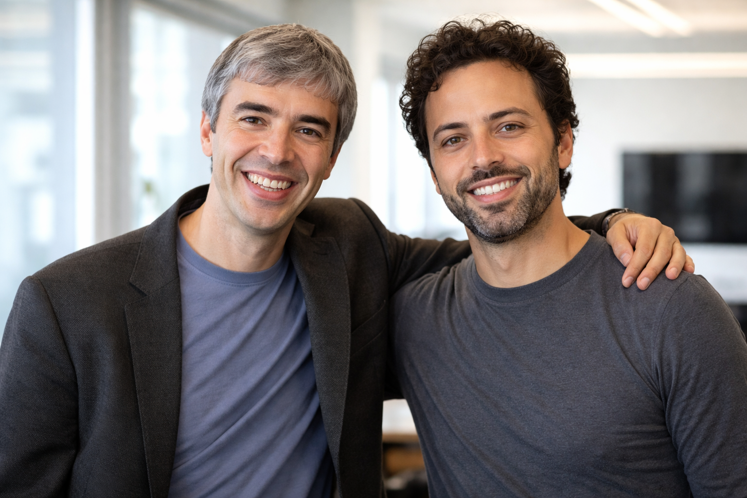
The Backrub Years (roughly 1996 to 1997)
Many people don’t realise that Google started as a college research project that was almost sold for $750,000.
Larry Page and Sergey Brin met at Stanford University in 1995. Larry was the quiet visionary, Sergey was the outgoing math genius.
BackRub was the original name of Google Search (hence “the BackRub Years”)

Slide 3
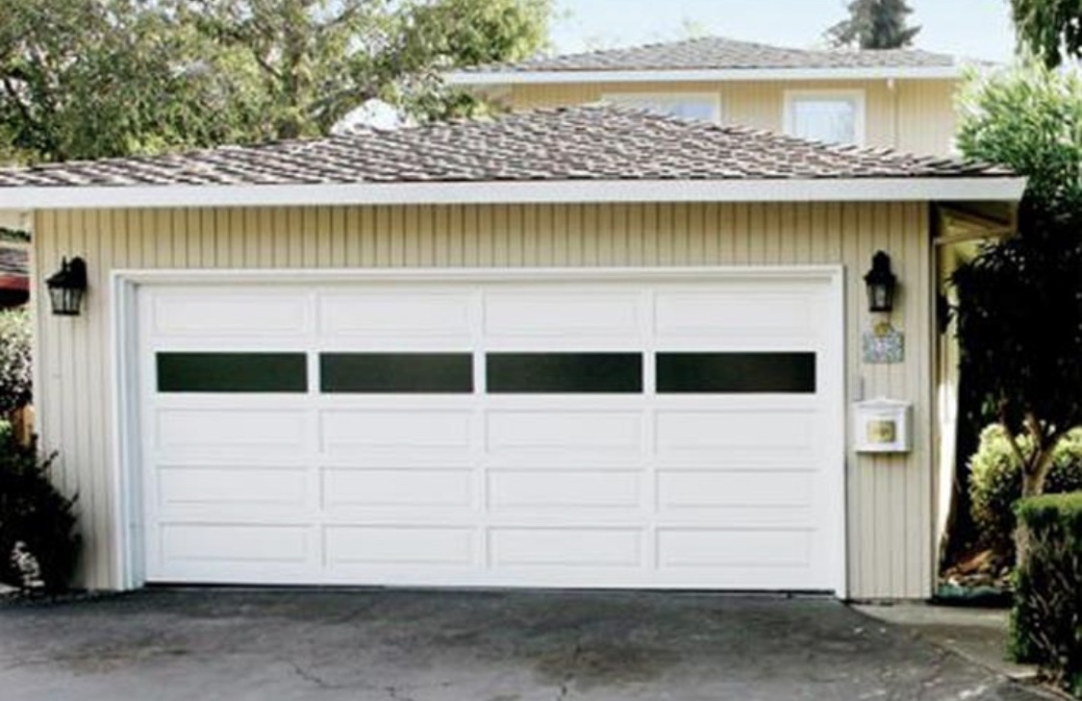
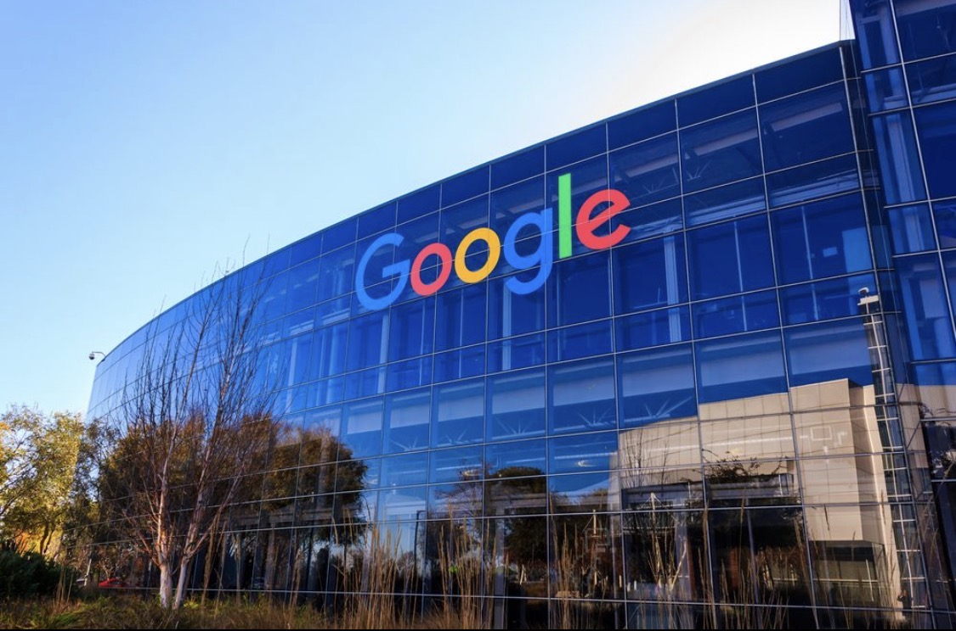
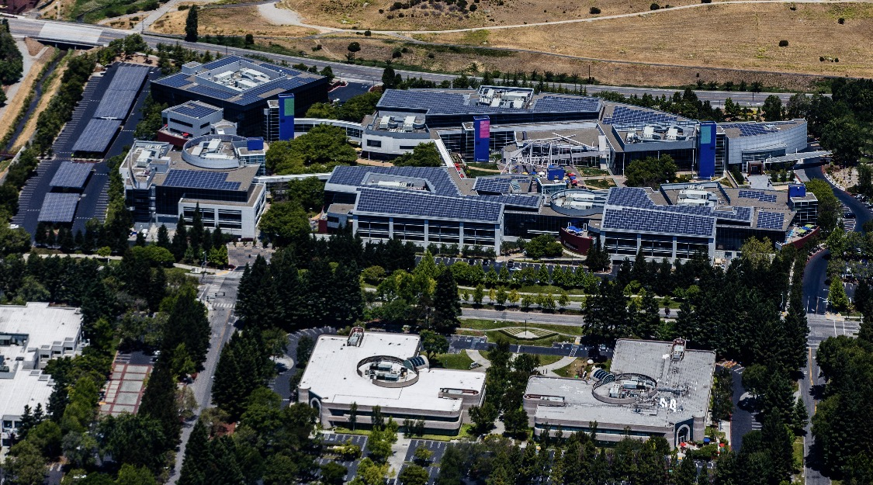
The garage in Palo Alto that Larry Page and Sergey Brin rented from Susan Wojcicki in 1998 as Google’s first workplace

Slide 4
Larry and Sergey founded Google in 1998 while they were PhD students at Stanford University.
The company initially operated out of Susan Wojcicki’s garage in Menlo Park, California, before moving to it’s first official office and later building the Googleplex headquarters in Mountain View, California.
The Google name comes from “Googol” which is 10 to the power of 100, or 1 followed by a hundred zeros, a very large number.
10,000,000,000,000,000,000,000,000
Who is Susan Wojcicki? She was employee number 16, became CEO of YouTube, a Google subsidiary. Passed away in 2024. Without her Google might not have had the same launch trajectory.

Slide 5
The Googleplex Campus - Google’s headquarters in Paulo Alto, California (Silicon Valley)

Slide 6
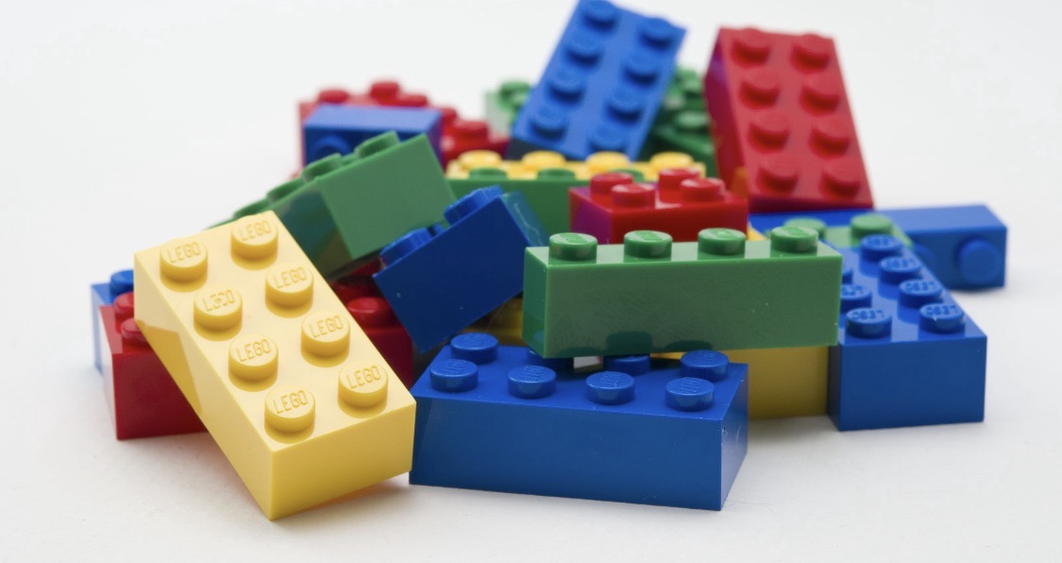
Larry Page once built a fully functioning inkjet printer out of LEGO bricks

Slide 7
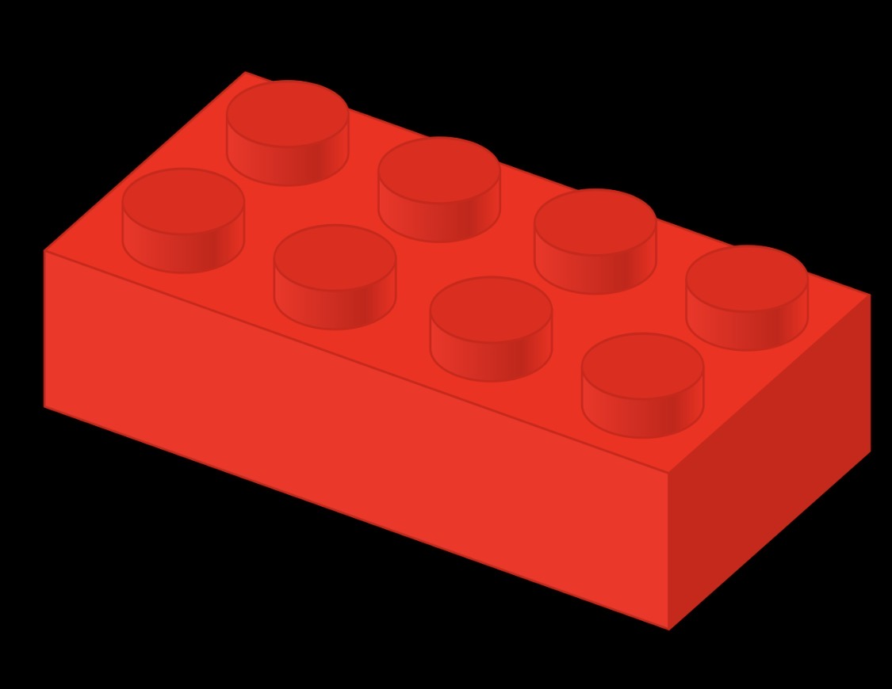
Larry and Sergey “built” the web block by block

Slide 8
Alphabet Inc
Google floated on the stock market in August 2004.
It restructured in 2015, creating a parent company and separating it’s core internet business from other ventures (Moonshots) like self-driving cars and health tech.
Alphabet’s Divisions and Ventures:
Google (Search, Android, YouTube, Gmail, etc.
X Lab (moonshots like Waymo self-driving cars)
Calico (anti-aging research)
Nest (smart home)
Verify (life sciences)
Fibre (broadband)
GV/CapitalG (venture funds)

Slide 9
Google in 2026
Motto:
Googles current moto after the 2015 restructuring is: “Do the right thing”.
Previous unofficial moto was “Don’t be evil”.
Google’s mission statement is:
“To organize the world’s information and make it universally accessible and useful.”
Vision:
“To provide access to to the world’s information in one click”.
Number of employees:
Alphabet has approximately 187,100 full time employees, encompassing Google and all it’s subsidiaries.
(Google employees are known as “Googlers”)

Slide 10
The Secret Sauce
Google’s Playful, Productive Offices
Googlers thrive in a perk-rich, flat-hierarchy space fostering creativity—free food fuels ideas, play sparks innovation.
Fun Spaces: Slides, nap pods and ping pong spark creativity.
Free Perks: Gourmet meals, gyms and snacks fuel energy.
Hybrid Flex: 3 office days, remote options, flexible hours.
Team Vibe: Flat hierarchy, stand-ups, open collaboration.
Daily Flow: Breakfast, deep work, recharge breaks.

Slide 11
Flat Hierarchy and Stand-Ups?
A FLAT HIERACHY means that there are fewer rungs on the ladder between an entry-level engineer and a Vice President. Managers often have a high number of staff reporting to them (sometimes 15 plus), which intensionally prevents them from micromanaging.
It empowers employees to make decisions without waiting weeks for approval. The are encouraged to reach out to anyone, regardless of their level.
STAND-UPS. If you walked into a Google office in the morning you might see a small team standing in a circle for 10 to 15 minutes. Each person answers 3 questions:
What did I do yesterday? 2. What am I doing today? 3. Is anything blocking my progress?
By standing up, the meeting stays short and uncomfortable. It keeps the team synchronised without wasting time.

Slide 12
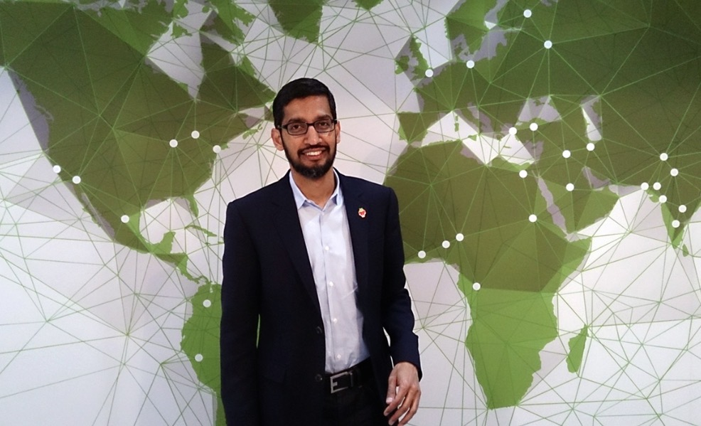
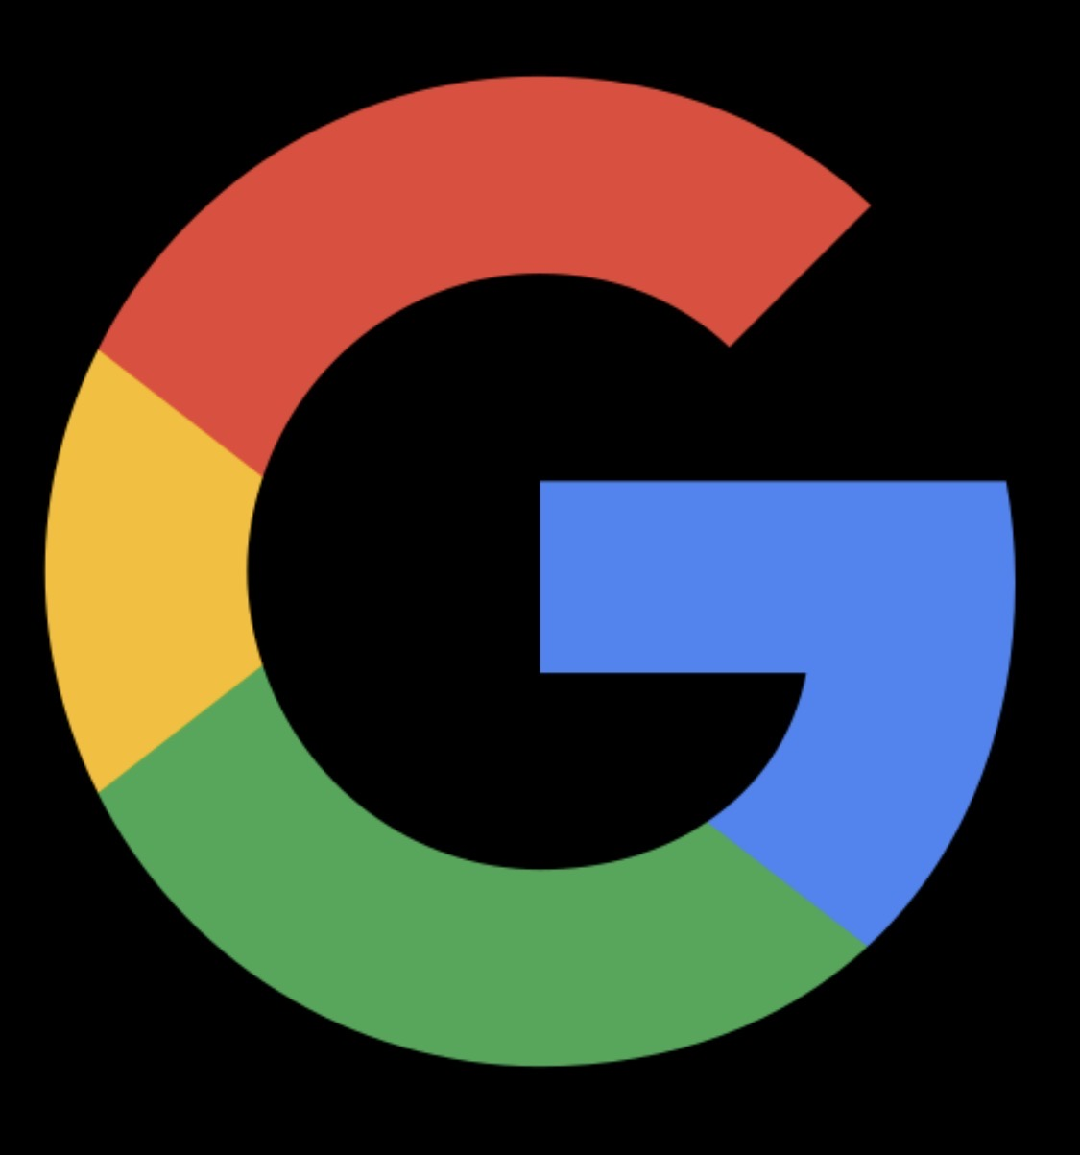
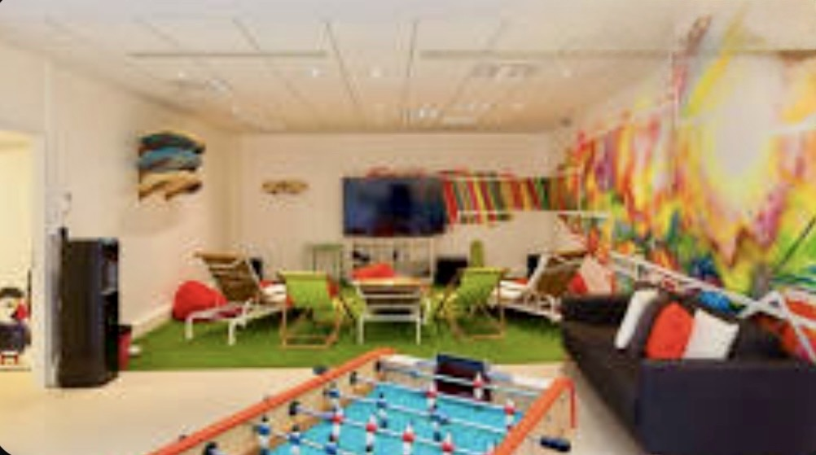
Google logo
Inside a Google office games room for employees
Sundae Pichai, became CEO of Google in 2015 and CEO of Alphabet in 2019.

Slide 13
“Ten things we know to be true”.
Google’s philosophy page summarises how it tries to operate in practice. Key ideas include:
Focus on the user and all else will follow.
Fast is better than slow.
It’s best to do one thing really well (Search)
Democracy on the web works (relying on links and user behaviour to rank content).
You can make money without doing evil
There’s always more information out there, and great just isn’t good enough.
(A user‑first and information‑centric philosophy: build products that help everyone get to useful information quickly, ethically, and at global scale)

Slide 14
Core Business
Google’s core business is selling online advertising that is targeted and delivered through its family of internet services, especially the Google Search engine, YouTube, and other consumer products like Maps and Android.
Google’s first commercial “enterprise” was the Google search engine itself, launched in 1998 as a company created to market the search technology originally developed by Larry Page and Sergey Brin at Stanford, which then became the foundation for its later ad‑driven business model.

Slide 15
The shift from search to ads.
Google built a fast, highly relevant search engine that attracted massive user traffic and trust.
They realised search queries show strong intent (e.g., “buy laptop”), creating valuable ad opportunities.
Launched text ads beside search results, clearly separated but tightly matched to user keywords.
Introduced AdWords and an auction‑based, pay‑per‑click model so advertisers only paid for clicks, not just views.

Slide 16
How the ad model scaled and took over.
Extended the same ad system across Google services (YouTube, Maps, Gmail, Android) to monetize the whole ecosystem.
Built an ad network to place Google‑served ads on third‑party sites and share revenue with publishers.
Used data (search history, location, device, browsing) to continually improve targeting and click‑through rates.
Result: search became the front end of a powerful advertising engine that funds most of Google’s free products.

Slide 17
“DON’T BE EVIL” was Google’s early motto
Google’s ad business depends on collecting extremely detailed profiles and broadcasting them to many third parties in advertising systems, even though Google says it does not literally sell raw databases of personal information.
Collects extensive information about you (searches, location, apps used, what you watch/read/buy, device identifiers, IP address, etc.).
Packages this into a profile or identifier and exposes it to many companies in ad systems so they can target you, with Google getting paid when ads are shown or clicked.
Allows other parties (ad tech firms, data brokers, app developers) to retain and reuse that “bidstream” or identifier data, which can be linked back to individuals.
Personal data is being commercialized and shared at large scale.

Slide 18
User’s Security and Privacy
It’s important to say that Google takes security very seriously, employing advanced protections like end-to-end encryption for many services, two-factor authentication by default in key areas, regular security audits, and rapid patching for vulnerabilities across Android, Chrome, and cloud platforms.
However, there are many privacy concerns, even though there are specific privacy controls in your Google account dashboard.

Slide 19
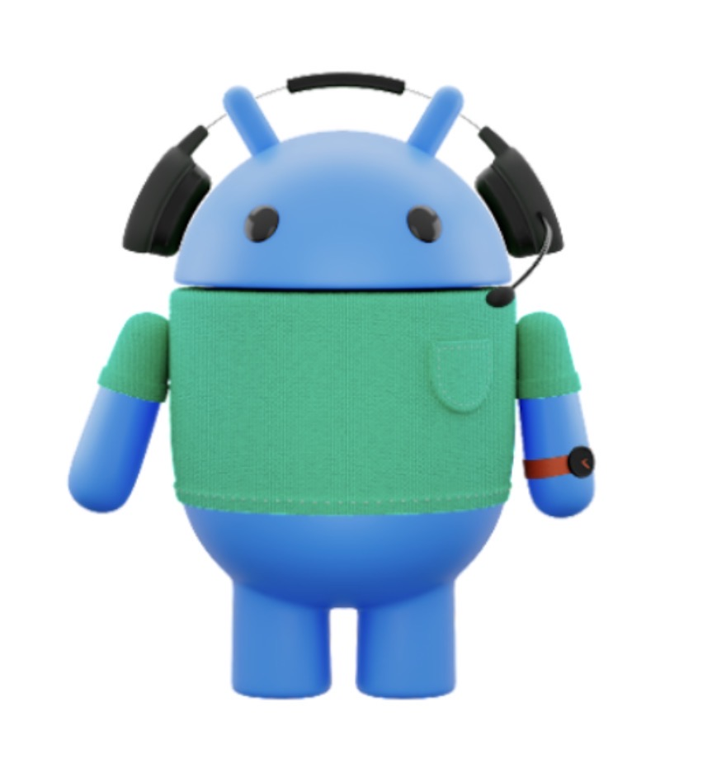
Bugdroid - Android’s logo

Slide 20
Android
Fairphone
Plus One
Amazon
Samsung
Asus
Sony
Xiaomi
Nokia / HMD
Realme
Oppo
ZTE
Honor
Motorola / Lenovo
There are up to 250 companies making Android phones.
There are currently about 4 billion Android phones in everyday use.

Slide 21
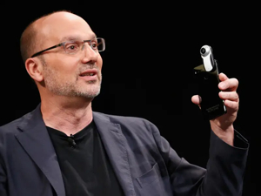
Google did not invent Android
Android is a mobile operating system created by Android Inc. and later acquired and developed by Google, designed primarily for smartphones and tablets.
Google agreed to acquire Android Inc. in July 2005, and the deal is widely reported to have been for about 50 million US dollars.
Andy Rubin co-founded Android Inc in 2003 and was it’s CEO. After Google acquired Android he became a senior vice president.
Android is a central and uniquely rich source in Google’s data‑collection system, though it works in concert with Google’s other sources such as web tracking, Gmail, Maps and YouTube.

Slide 22
Basic idea
Android is built on the Linux kernel and other open‑source components, providing a flexible platform manufacturers can customize for different devices
It is designed to run apps written mainly in Java/Kotlin and distributed through app stores such as Google Play.
Android was first publicly released as an operating system in 2008. The first commercial version, Android 1.0, debuted on the HTC Dream. (This was one year after the release of the first iPhone)
New releases are usually annually, just like Apple’s iOS.
Versions up to version 9, (Pie) were named after deserts, such as Ice Cream Sandwich for version 4.0 and Nougat for version 7.0.
From Android 10 in 2019 Google use numbers only but they still use desert codenames internally.

Slide 23
Android and AOSP
AOSP stands for Android Open Source Project. Google releases the source code when Android has been updated for other companies to use freely.
It has many companies as members, such as Samsung, Qualcom, Intel, HTC, Sony, who contribute to it via the Open Handset Alliance, (AHA). They provide code, patches and drivers.
Android is the full operating system as shipped on consumer devices. AOSP is it’s open source core. Anyone can use it to build phones, TVs, watches, car software, servers, etc, without Google services, (apps or ecosystem lock-in).
You add your own app store, services, or nothing at all; it’s fully functional for basic telephony, browsing, and apps that don’t rely on Google APIs.
Examples include Chinese brands (Huawei HarmonyOS base, Xiaomi’s MIUI without GMS) and privacy-focused custom ROMs.
A custom ROM (Read-Only Memory) is a modified version of Android built from AOSP source code by third-party developers or communities.

Slide 24
Googles Competitors and Partners
Google’s competitors often double as partners in specific areas like cloud, AI, hardware, and search distribution.
Key examples:
Apple: Primary smartphone rival (iOS vs Android), yet partners with Google—paying billions annually to set Google as the default Safari search engine, and now using Google’s Gemini AI models to power advanced Siri and Apple Intelligence features launching in 2026.
Samsung: Competes in premium Android phones but is a close manufacturing and AI collaborator, bundling Google services deeply and leveraging Gemini for Galaxy AI features while co-developing chips and ecosystem tech.
Microsoft and Amazon: AI rivals (via OpenAI/Anthropic investments) who partner with Google Cloud on multi-cloud deals, interoperability, and joint customer projects, despite cloud market competition.
Almost all of Google’s apps and services are available on other platforms, such as Apple’s iPhone and iPad. They can also be accessed with a web browser.

Slide 25
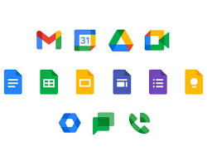
GOOGLE ECOSYSTEM
Google offers a massive ecosystem of apps, services and hardware.
In 2026, Google is trying to remove the "friction" of opening apps entirely. You provide the intent, and the ecosystem provides the action. (“Agentic Commerce”)

Slide 26

Gemini and The Future of Search
Gemini 3: The core multimodal AI powering all platforms: features Gemini Live for real-time voice and vision interaction.
AI Search and Agents: Shift from “Links” to “Actions” - conversational search that books travel, buys products, and manages tasks.
Creative Suite: Nano Banana: High-fidelity text-to-image and editing. Veo 3: Cinematic-quality video and audio generation.
Knowledge Tools: NotebookLM for personalised research and automated audio deep-dives.

Slide 27
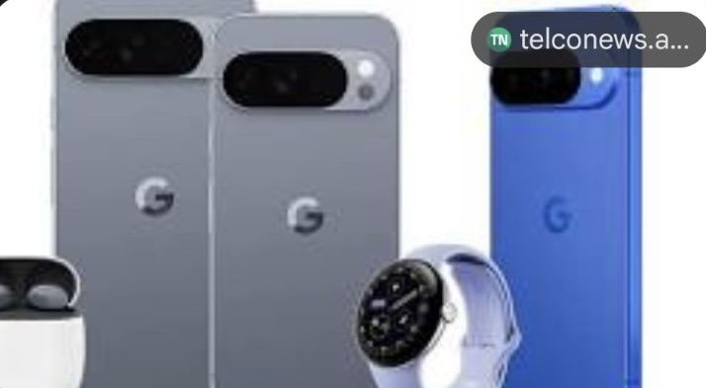
Hardware and Workspace
Connected Devices and Intelligent Productivity
Pixel 10 Series: Flagship smartphones (Pro, XL, Fold) powered by the Tensor G5 chip for on device AI.
The AI Home: Pixel Watch 4 (Health Coaching) and Nest smart home devices with generative event descriptions.
Google Workspace Studio: AI-enhanced Docs, Sheets and Gmail; allows users to build custom, shareable AI agents for work
Google Beam: Reimagined video conferencing using 3D “holopresence” technology for Google Meet.

Slide 28
Google’s Strategic Pivot: From Ads to Ecosystem
Hybrid Monetization
Google is transitioning from a purely ad-supported model to a diversified subscription strategy to offset high AI compute costs and market volatility.
• Premium UX (YouTube): Bundling ad-free viewing with music streaming and exclusive features.
AI-as-a-Service (Gemini): Monetizing high-compute Generative AI through the Google One AI Premium tier.
Infrastructure (Google One): Converting basic cloud storage into a tiered "utility" subscription.
Hardware Synergy: Locking advanced features for Nest and Fitbit behind recurring service fees.
Strategic Objectives
1. Revenue Stability: Creating predictable, recurring income independent of the ad market.
2. Cost Recovery: Funding the massive infrastructure required for Generative AI.
3. User Retention: Increasing "ecosystem stickiness" by bundling storage, AI, and entertainment.

Slide 29
What are Larry Page and Sergey Brin doing now?

Slide 30
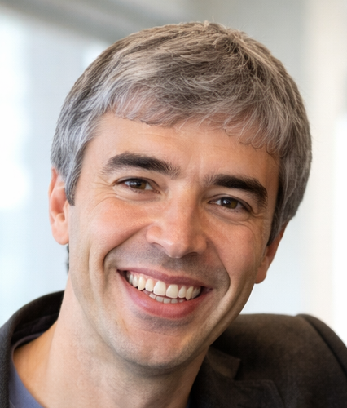
Larry Page
(Now aged 52)
Status: Co-founder of Google, no longer in day-to-day management.
eft executive roles: 2019 (stepped down as Alphabet CEO).
What he does now:
Focuses on long-term, high-risk technology ideas.
Strong interest in AI, advanced manufacturing, and transport
Previously backed projects like flying vehicles (Kitty Hawk) and deep-tech R&D.
Public profile: Very low. Rare interviews, keeps out of the spotlight.
Still involved? Yes — as a major shareholder and informal technical advisor.

Slide 31
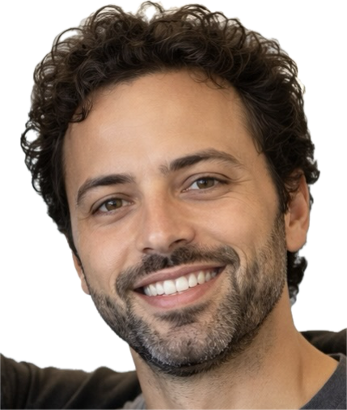
Sergey Brin
(Now aged 52)
Status: Co-founder of Google
Left executive roles: 2019
What he does now:
Has been more hands-on than Page in recent years
Has been more hands-on than Page in recent years
Returned internally to help with Google’s AI efforts, especially after the rise of ChatGPT
Actively interested in AGI, AI safety, and frontier research
Public profile: Low, but slightly more visible than Page.
Still involved? Yes — he occasionally works with Google DeepMind teams.

Slide 32
Big Picture
Sundar Pichai runs Google & Alphabet
Page & Brin:
Control the company via super-voting shares
Drop in when something is strategically or existentially important (AI is one of those moments)
Think in 10–20 year horizons, not quarterly earnings

Slide 33
Google is becoming an AI infrastructure company
Google is at a turning point and Android is right in the middle of it
Google’s future = AI first, everything else second
Android’s future = the place your AI lives
Phones matter less; context matters more
The next OS war is: Who controls the agent layer. Who controls the agent that acts
Best-case for Google
Android + Gemini becomes the default personal AI
Developers build for agents, not screens
Google retains “platform dominance” — just in a new form
Worst-case for Google
Apple nails private, on-device AI
OpenAI controls the agent layer
Android becomes “just another place where the AI shows up”
That’s why Google is moving fast — and sometimes messily.

Slide 34
Google Timeline
1998 – Search
2000 – Ads
2004–06 – Consumer apps (Gmail, Maps, YouTube)
2007–08 – Platforms (Android, Chrome)
2014–16 – AI pivot (DeepMind, Alphabet, Assistant)
2023–26 – AI agents (Gemini era)

Slide 35
Thank you

