Slide 1
The Robots are Coming
AI: What it is and how will it impact our lives today and in the future
Keith Llewellyn 27/03/2026

Slide 2
What is AI?
Artificial Intelligence is the ability of computers to learn from data and perform tasks that normally require human intelligence.
Example of tasks:
Recognising images
Understanding speech
Making predictions

Slide 3
How AI Works
1. Data - large numbers of examples
2. Learning - algorithms find patterns
3. Prediction - the system applies what it has learned
Data → Learning → Prediction
📊 → 🧠 → 🎯

Slide 4
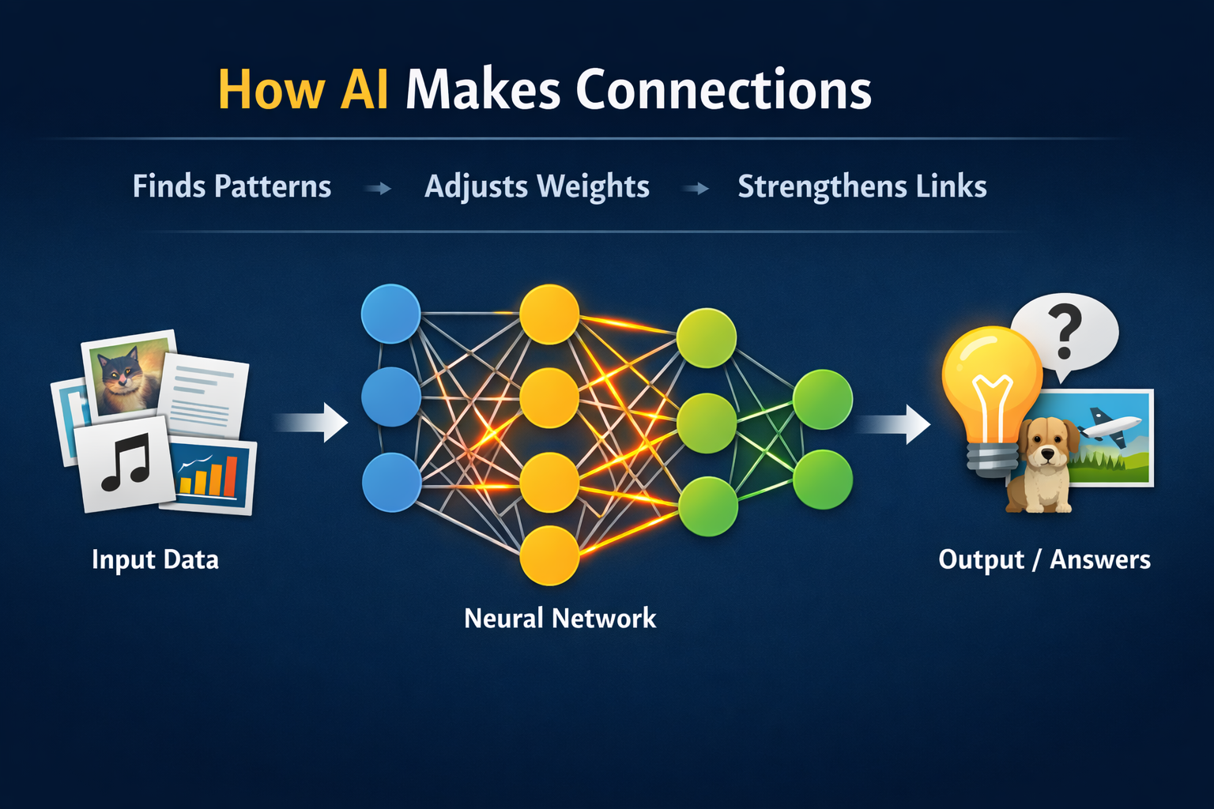
AI makes connections by finding patterns in massive datasets and strengthening relationships between things that frequently appear together.
This is a very simple “neural network” diagram that illustrates connections visually.

Slide 5
How AI Makes Connections
It looks at huge amounts of data Text, images, numbers, sounds, etc.
It notices patterns and relationships For example, it may see that the words “doctor” and “hospital” appear together very often.
It adjusts internal weights Inside many AI systems (especially those based on Artificial Neural Network) there are thousands or millions of tiny connections. Each connection has a weight — a number showing how strong that relationship is.
Learning strengthens useful connections When the AI gets an answer right, the useful connections get stronger. When it’s wrong, they get weakened or adjusted.

Slide 6
Simple Analogy
Think of it like paths in a field:
At first there is just grass.
The more people walk a route, the clearer the path becomes.
Eventually you get obvious well-worn paths between places.
A language AI trained through Machine Learning might learn connections like:
“tea” — “cup” “rain” — “umbrella” “Paris” — “France”
When it sees the start of a sentence, it uses those learned connections to predict what is likely to come next.

Slide 7
Everyday Examples of AI
• Voice assistants (speech recognition)
• Email spam filters
• Online recommendations
• Medical image analysis
• Navigation and traffic prediction

Slide 8
Limits of AI
AI is powerful, but:
It depends on good data
It can make mistakes
It does not understand as humans do
It still needs human oversight
AI is best thought of as a powerful pattern-recognition tool that helps humans make better decisions

Slide 9
Why AI Matters
AI can help us:
Understand complex data that humans cannot easily analyse
Automate routine tasks and improve efficiency
Make better predictions in areas like health, climate and transport
Create new tools and services that change how we live and work

Slide 10
All jobs are affected by AI
In 1900, nearly half of all jobs were in farming. Today it’s just 2%. At the same time, around 60% of today’s jobs didn’t even exist in 1940.
Advances in technology have been the main driver of this transformation in work.

Slide 11
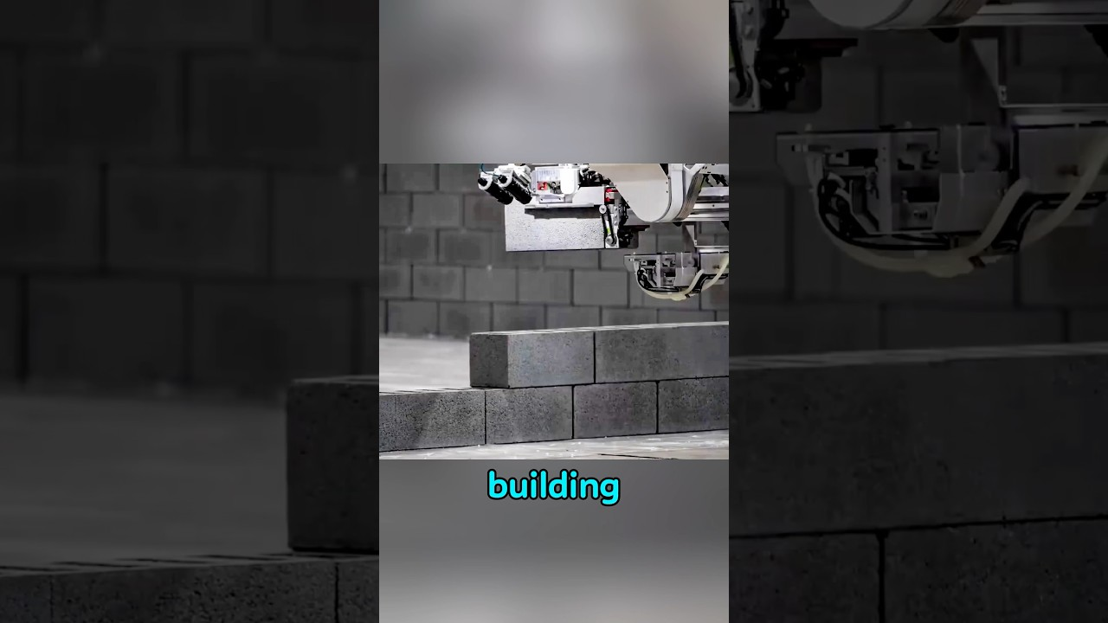
This is a real world example. The Hadrian X bricklaying robot in action:

Slide 12
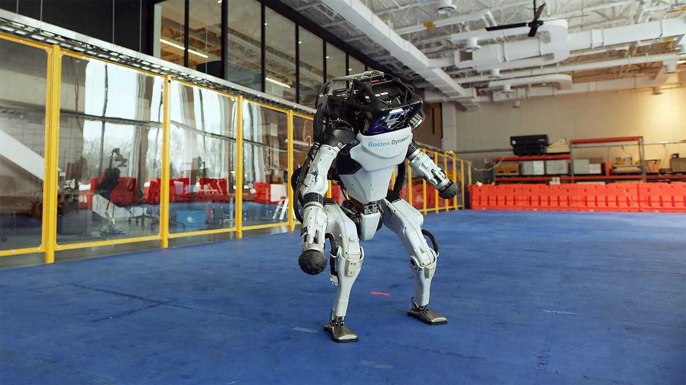
Boston Dynamics robots dancing

Slide 13
We’ve largely solved how to make robots move. We haven’t yet solved how to make them work.
Or have we?
That’s it for now.
Time for a discussion

